Slide 1
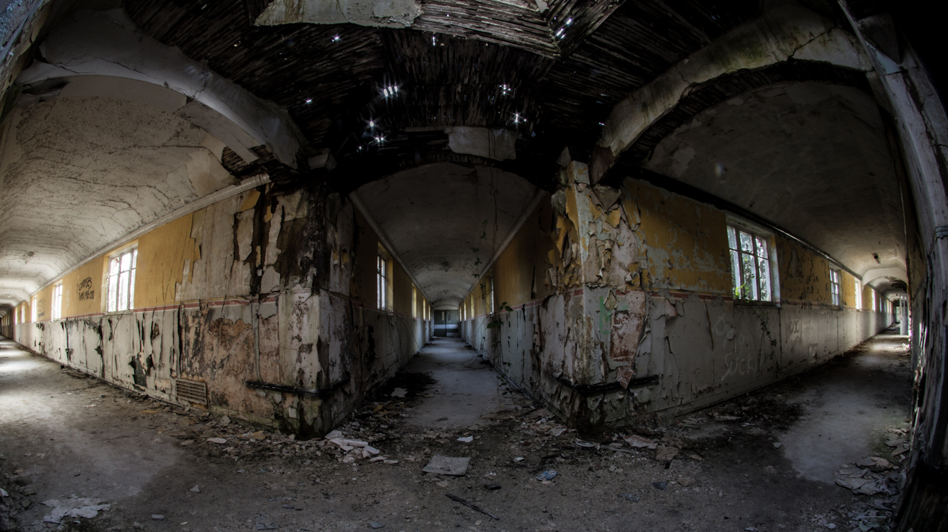
THE WARD
Created by Team 12

Slide 2
Trailer
https://drive.google.com/file/d/0BzR41_vwJP3PNWExNldSRGlvQ1U/view

Slide 3
Game Overview
“The Ward” is a text based, first person, adventure game.
You play as a doctor in a mental asylum. An inmate has managed to escape from his cell. The aim is to escape the mental asylum, kill the cannibal, or call for help.

Slide 4
Features
Images
Audio
Combat
Strategy Driven
Multiple Endings

Slide 5
Third Party Libraries
Pillow
- Allows image input and control
Simple Audio
- A simple cross platform audio interface

Slide 6
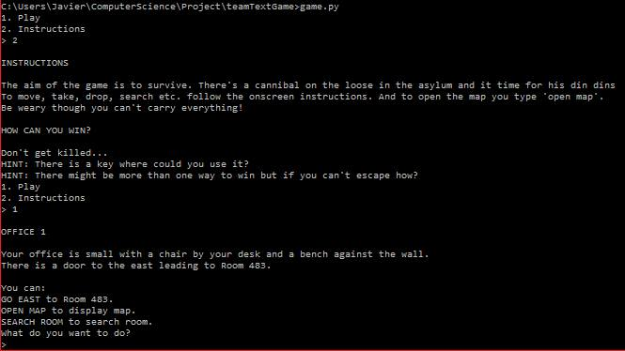
Demonstration
We will now show you a demonstration of the game

Slide 7
Questions?
We hope you enjoyed the presentation.
We will be happy to answer any questions.

